Slide 1



K-Nearest Neighbor
Data Mining
Lê Công Minh Khôi – 519H0181

Slide 2
Introduction
Simple algorithm
Classification/Regression
Based on a similarity measure

Slide 3
1970s
Statistical estimation
Pattern recognition

Slide 4
1990s
Popular in machine learning

Slide 5
Why do we need a kNN algorithm?
Simple To Implement
Versatile
Effective

Slide 6
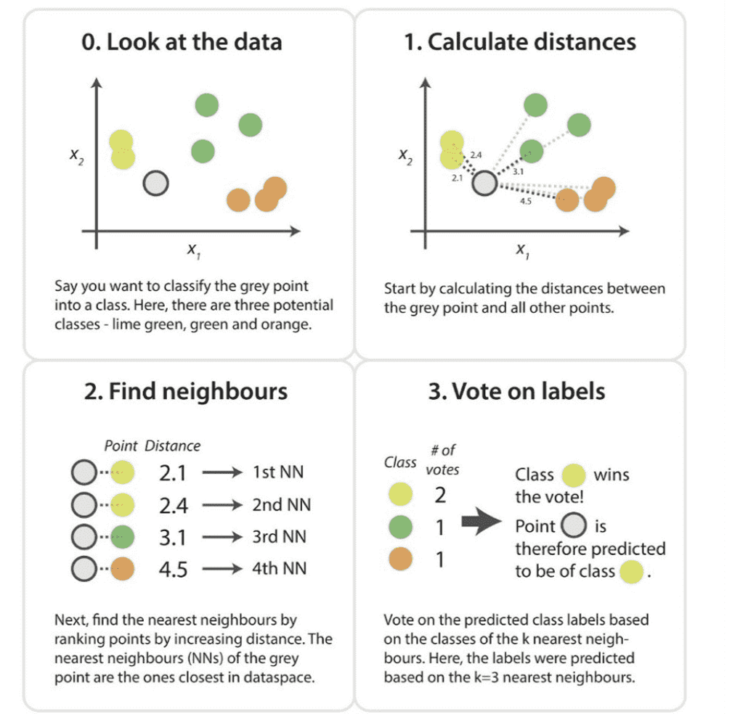
How does the kNN algorithm work?
The kNN algorithm assumes that similar things exist in proximity.

Slide 7

Step by step explanation
Load the data
Choose k
For each point in the data
Calculate the distance between current point and the point we try to predict
Add the distance and the index of the example to an ordered collection
Sort the ordered collection of distances and indices from smallest to largest (in ascending order) by the distances
Pick the first k entries from the sorted collection
Get the labels of the selected k entries
Return prediction
If regression, return the mean of the k labels
If classification, return the mode of the k labels

Slide 8


How to choose the value of k?
Usually odd
k
sensitive to noise
Try different k value

Slide 9
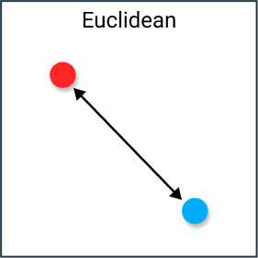
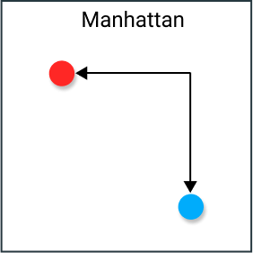
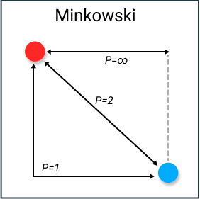
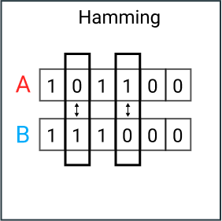
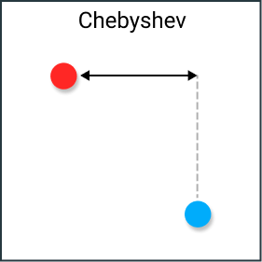
Calculating the distance
Euclidean
Manhattan
Minkowski
Hamming
Chebyshev

Slide 10


Advantages
Simple to implement
Versatile
Training is trivial
Works with any number of classes
Effective if the training data is large

Slide 11
Disadvantages
Computationally expensive
High memory requirement
One-hot encoding is required for categorical features
Does not work well with high dimensional data

Slide 12

Thank you
Please keep in mind your questions

